Slide 1
Vulnerabilities And Threats Of Network Security

Slide 2

Threat
Threat:
threat is a sign or warning that someone or something may cause harm or trouble.
in cybersecurity, a threat is anything that has the potential to cause serious harm to a computer system or network.

Slide 3
Threats examples
here are a few examples to illustrate different kinds of threats:
Physical Threat: If someone says they are going to hit you, that's a physical threat.
Cyber Threat: A hacker might threaten to break into a computer system and steal sensitive information.
Environmental Threat: Pollution is a threat to clean air and water.
Health Threat: A new virus can be a threat to people's health.

Slide 4
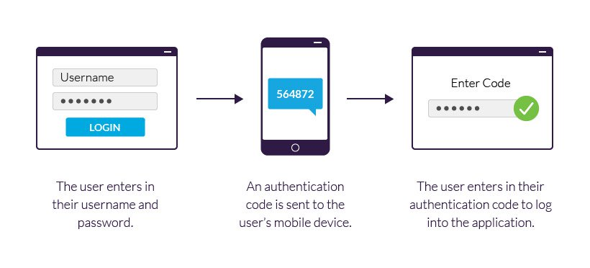
Authentication
Authentication: This is the process of verifying the identity of a person or device. This can involve passwords, biometrics, or other forms of identification.

Slide 5
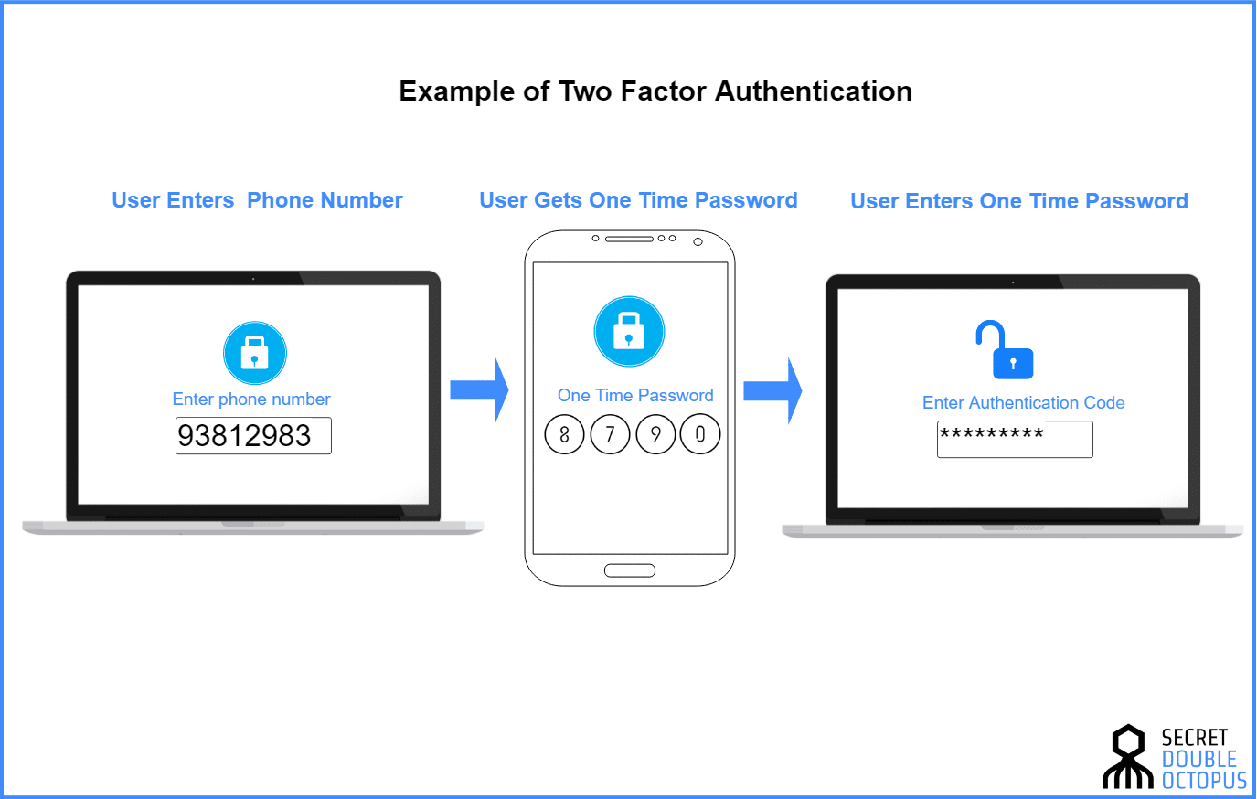
Two-Factor Authentication
Two-Factor Authentication (2FA): is a security process where you use two different methods to prove your identity when logging into an account.

Slide 6
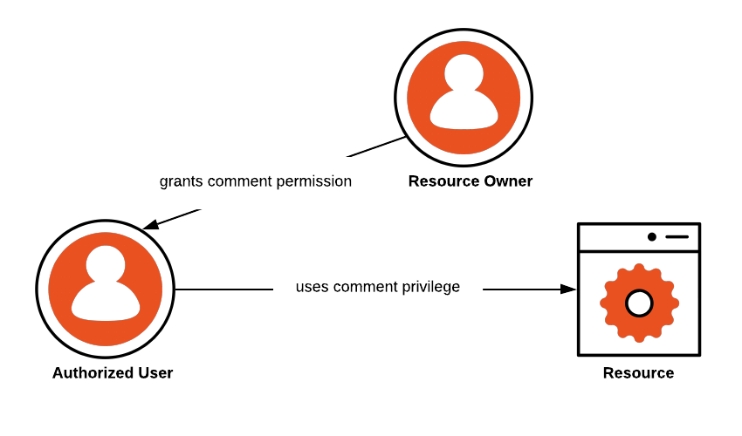
Authorization
Authorization: Once identity is established, authorization is the process that determines what an authenticated person or service is allowed to do. This might include access to files, databases.

Slide 7
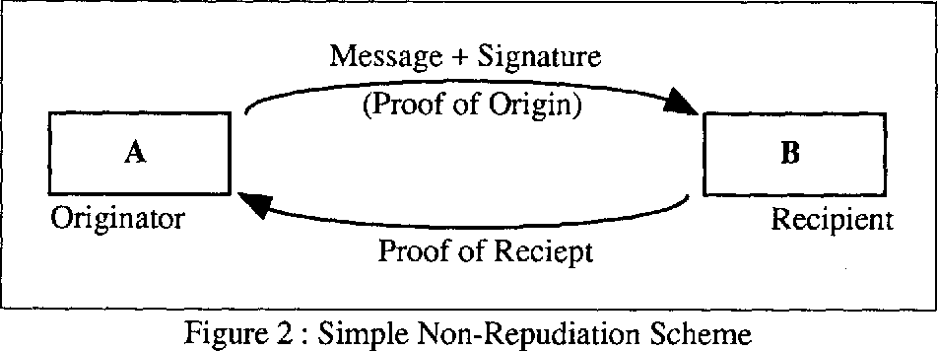
Non-repudiation:
Non-repudiation: This is a way to guarantee that someone cannot deny the validity of something. Digital signatures and secure records are used to enforce non-repudiation.

Slide 8
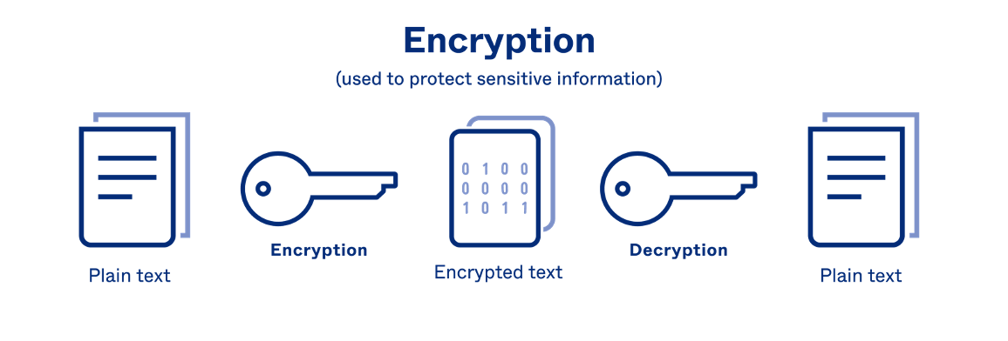
Encryption
Encryption: The process of encoding data to prevent unauthorized access. Encryption uses algorithms to transform readable data into an unreadable format.

Slide 9
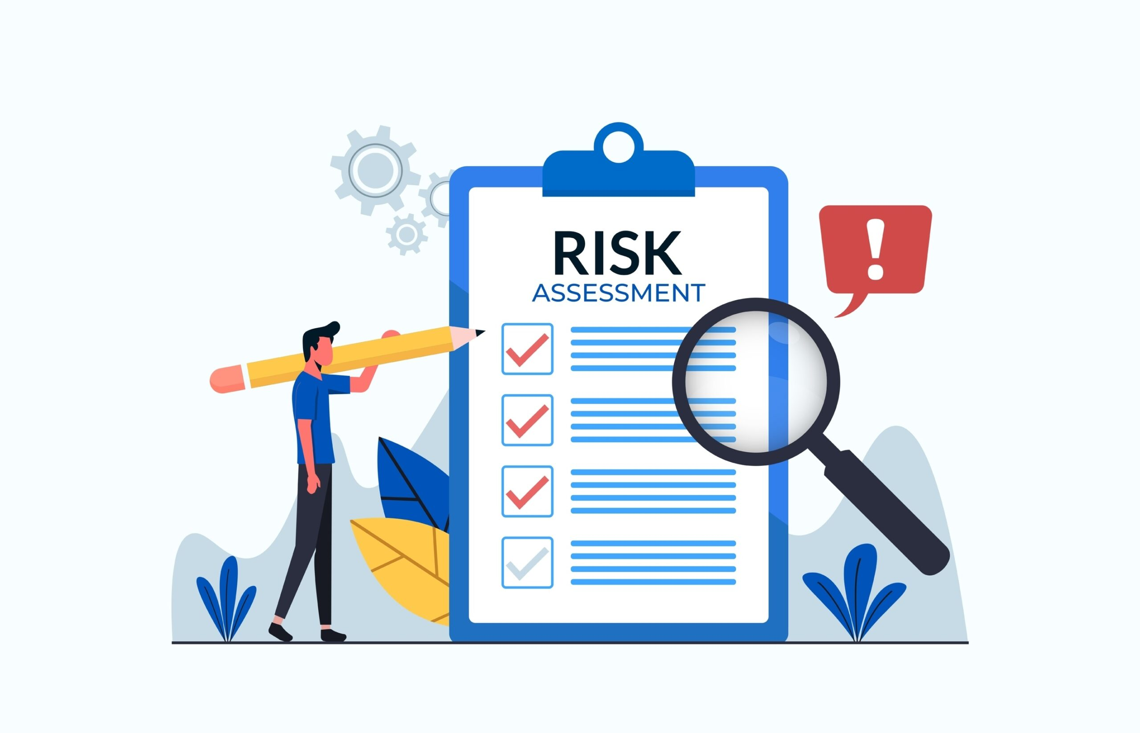
Risk Assessment
Risk Assessment: This is the process of identifying, analysing, and evaluating risk. It helps to identify the potential threats to an organization's information systems and data, and to establish appropriate defences to protect against those threats.

Slide 10
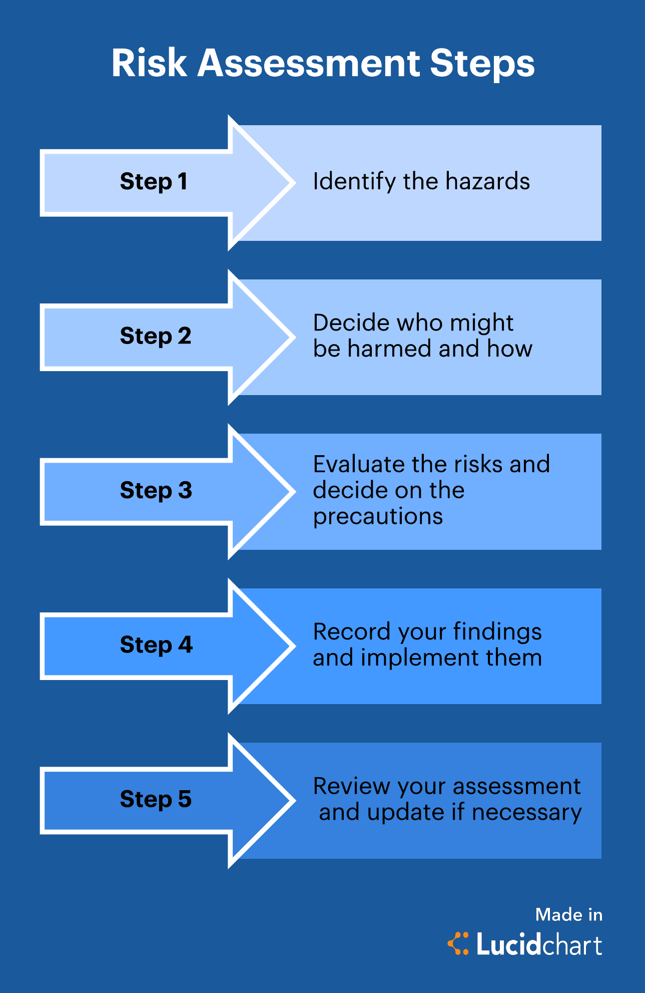
Risk Assessment Steps

Slide 11

Patch Management

Slide 12
Patch Management
Patch Management: The process of managing updates for software applications and technologies. This includes update, testing, and installing multiple patches (code changes) to an administered computer system.

Slide 13

Hackers
Hackers: are individuals or groups of individuals who gain unauthorized access to computer systems or networks.
White Hat: White hats are ethical hackers who work to protect systems.
Black Hat: Black hats are criminals who seek to exploit weaknesses.
Gray Hat : Gray hats fall in between, sometimes operating legally and other times not..

Slide 14
Attack
Attack:
An attack is a specific technique used to exploit a vulnerability.
For example, a threat could be a denial of service. A vulnerability is in the design of the operating system, and an attack could be a "ping of death.“

Slide 15
Type of attacks
There are two general categories of attacks, passive and active.
Passive attacks: These attacks are typically aimed at eavesdropping or gaining access to sensitive information without altering or affecting the data in any way. Ex (packet sniffing).
Active attacks: These attacks involve modifying or affecting data in some way, with the goal of gaining unauthorized access or causing damage to the system or network. EX(DDOS)

Slide 16

Vulnerability
Vulnerability: weakness in a system that could be exploited by hacker to cause harm or unauthorized actions within a computer system.

Slide 17
Vulnerabilities sources
Most vulnerabilities can usually be traced back to one of three sources:
Poor design: Hardware and software systems that contain design flaws that can be exploited.
Example: the "sendmail" flaws in early versions of Unix
Poor implementation: Systems that are incorrectly configured, and therefore vulnerable to attack.
This type of vulnerability usually results from inexperience, insufficient training.
Example: unrestricted access privileges on critical executable files.

Slide 18
Vulnerabilities sources
Most vulnerabilities can usually be traced back to one of three sources:
Poor Maintenance: security measures need to be documented and monitored.
Daily backup of a system needs to be verified.

Slide 19

Discover vulnerabilities
Hackers often discover vulnerabilities through a combination of techniques and methods:
Scanning and Enumeration:
Port Scanning: Hackers use tools like Nmap to identify open ports and services on a target system. This can help them identify potential entry points.
Service Enumeration: Once open ports are identified, hackers probe the services running on those ports to gather information about the software and versions in use.

Slide 20
Discover vulnerabilities
Hackers often discover vulnerabilities through a combination of techniques and methods:
Observation : This involves gathering information about the target through sources like social engineering, public records, or online research. It helps hackers build a profile of potential targets and find weak points.

Slide 21


Discover vulnerabilities
Hackers often discover vulnerabilities through a combination of techniques and methods:
Vulnerability Scanning: Hackers use automated scanning tools to identify known vulnerabilities in software, operating systems, or web applications. Tools like Nessus and OpenVAS can help identify these weaknesses.

Slide 22

Discover vulnerabilities
Hackers often discover vulnerabilities through a combination of techniques and methods:
Traffic Analysis: Analysing network traffic can reveal vulnerabilities, especially when hackers detect patterns that suggest weaknesses in the network architecture or data transmission.

Slide 23
Activity
Use the internet, news, and academic sources to research cyber security in the Internet of Things.
Complete the following tasks:
Task 1: Find out information about 3 cyber security attacks that involved IoT devices.
Task 2: Research the vulnerabilities that these IoT devices had that made them susceptible to the cyber attacks.
https://coventryunionline.padlet.org/ae09041/activity-ikh2yghzmdt2vc0q

Slide 24
What’s next on the agenda?
Break: 20 minutes
Lab Explanation
Lab Work

Slide 25


